Slide 1
Gender Mainstreaming in Flood Management in West Africa
The SERCOM-2 Side Event:
WMO best kept secret - Associated Programme on Flood Management (APFM) 20 years and continuing
Date and Time: Tuesday 18 October 2022, 17:00 - 18:00 CEST
Location: Salle Obasi, WMO
Dr. Constance Awinpoka Akurugu
SDD UBIDS- Wa, Ghana

Slide 2
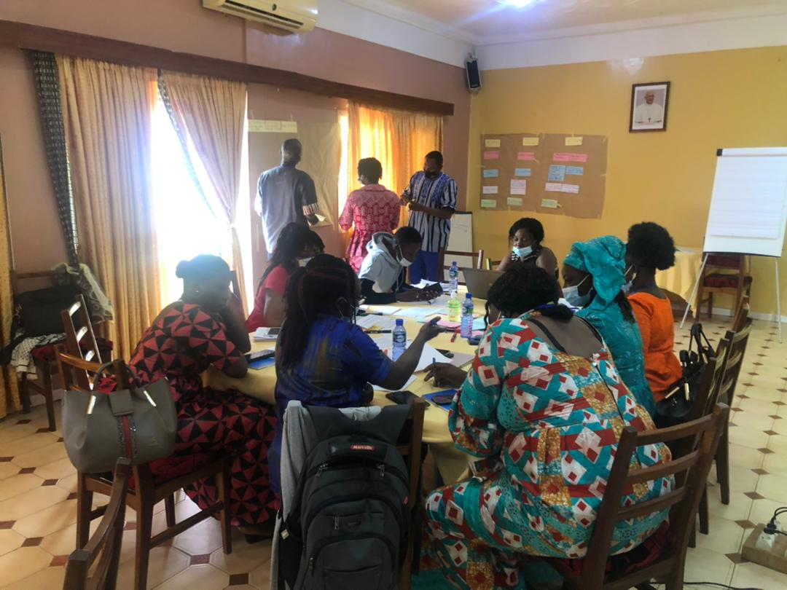
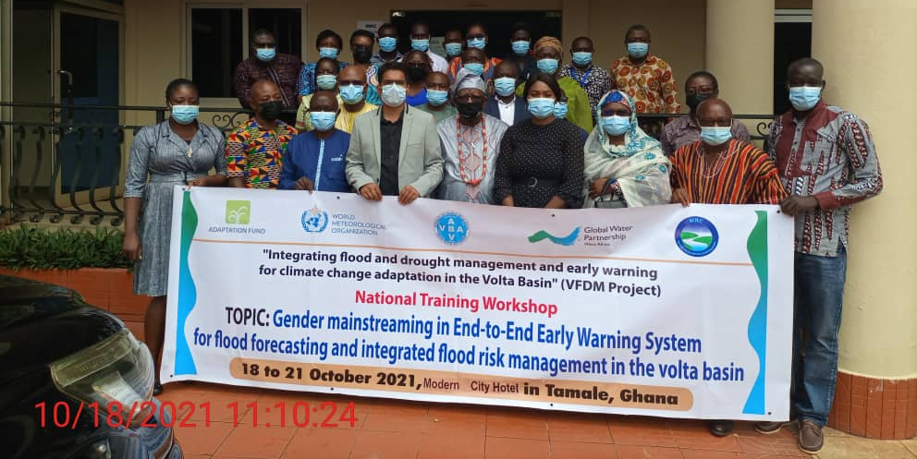
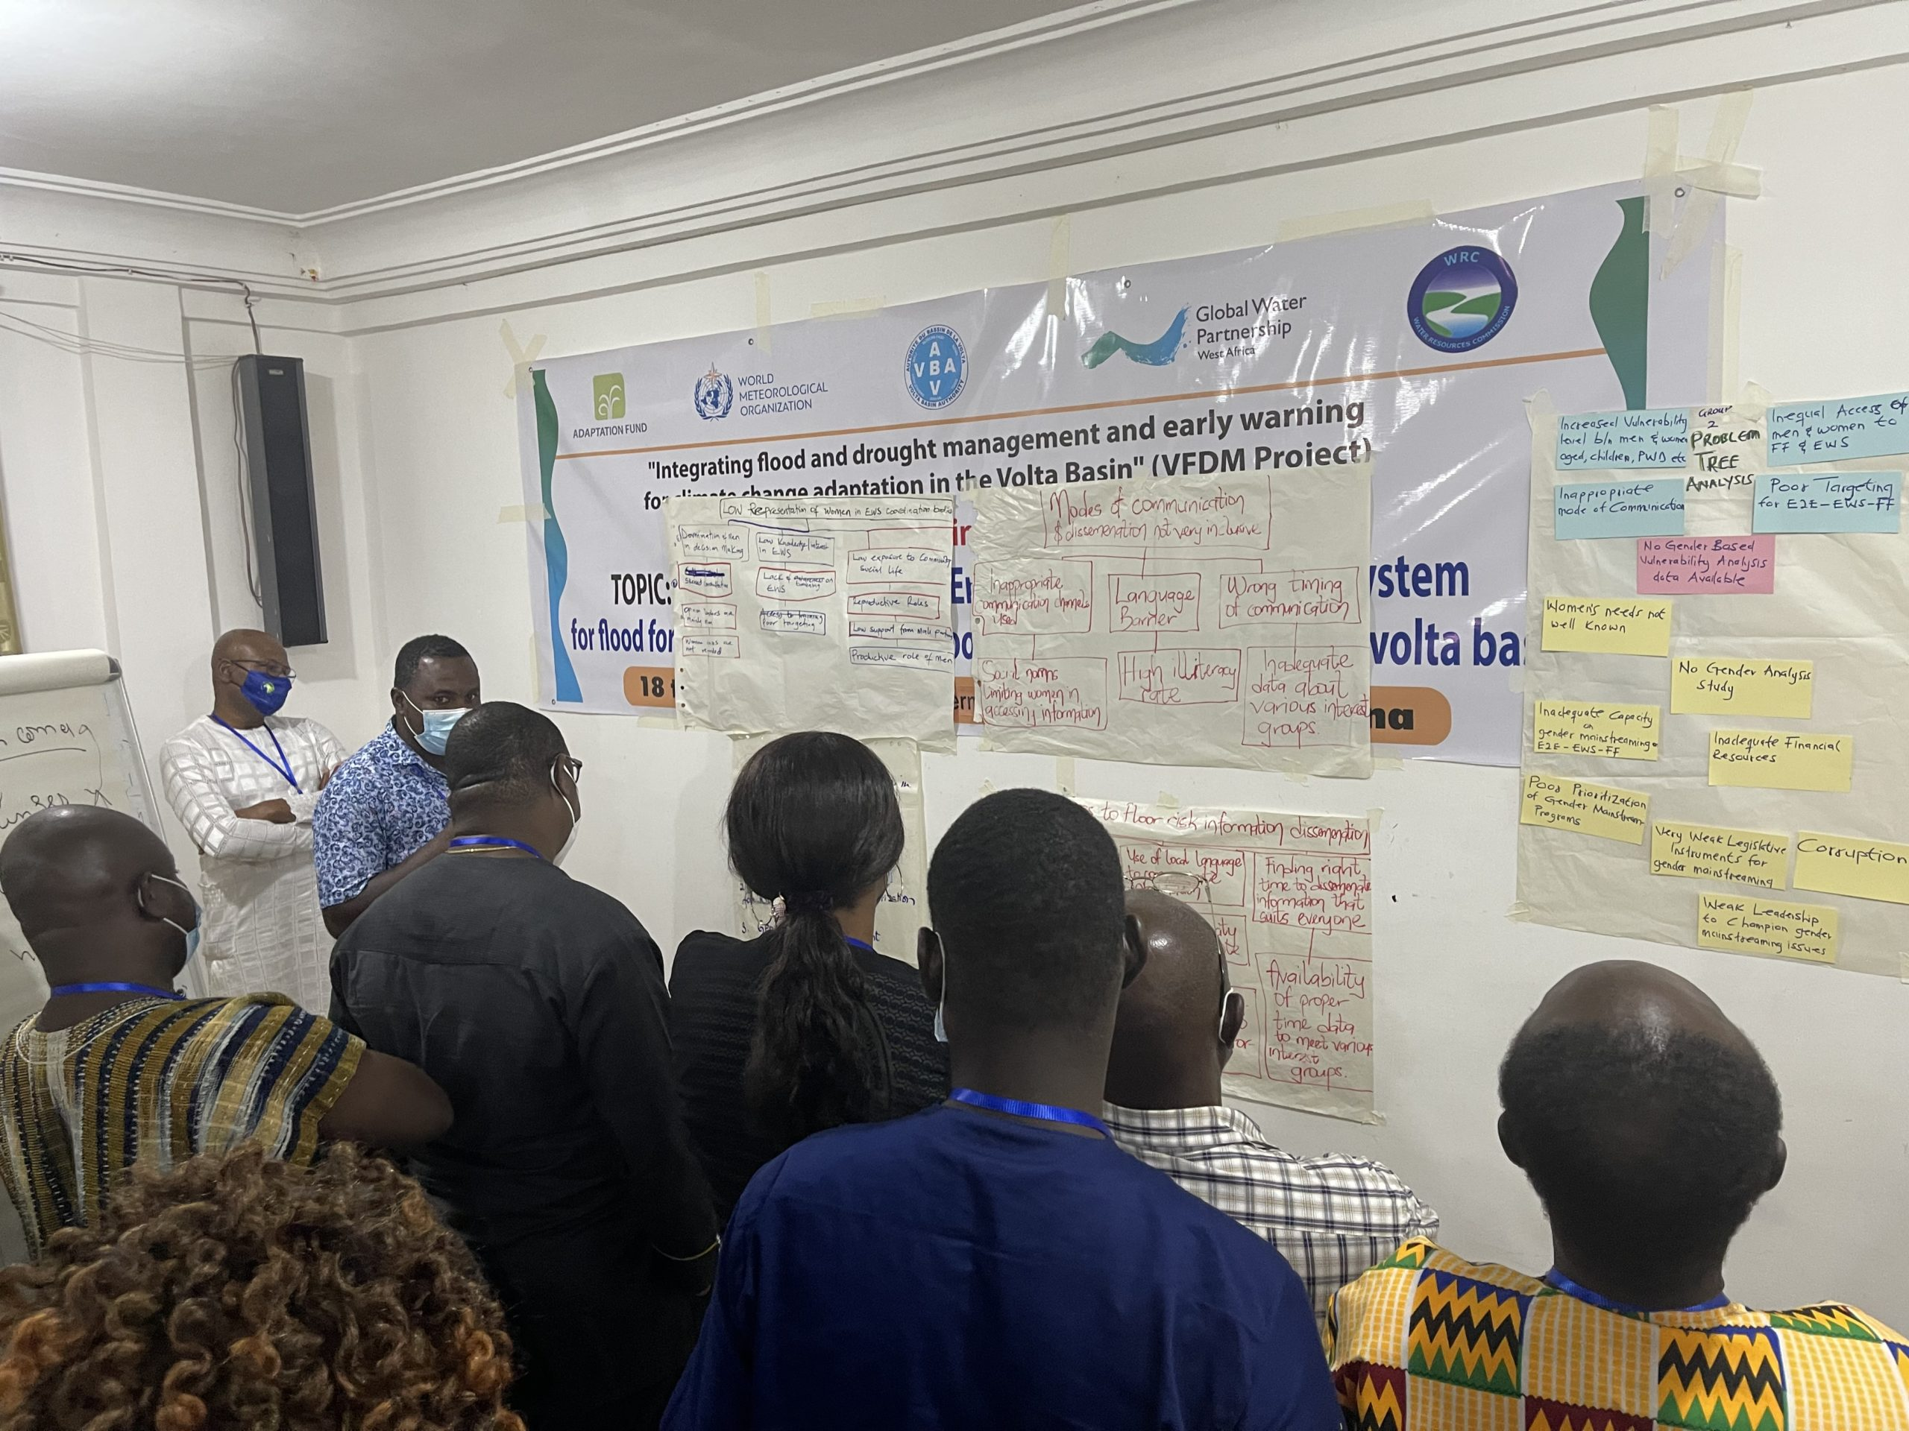
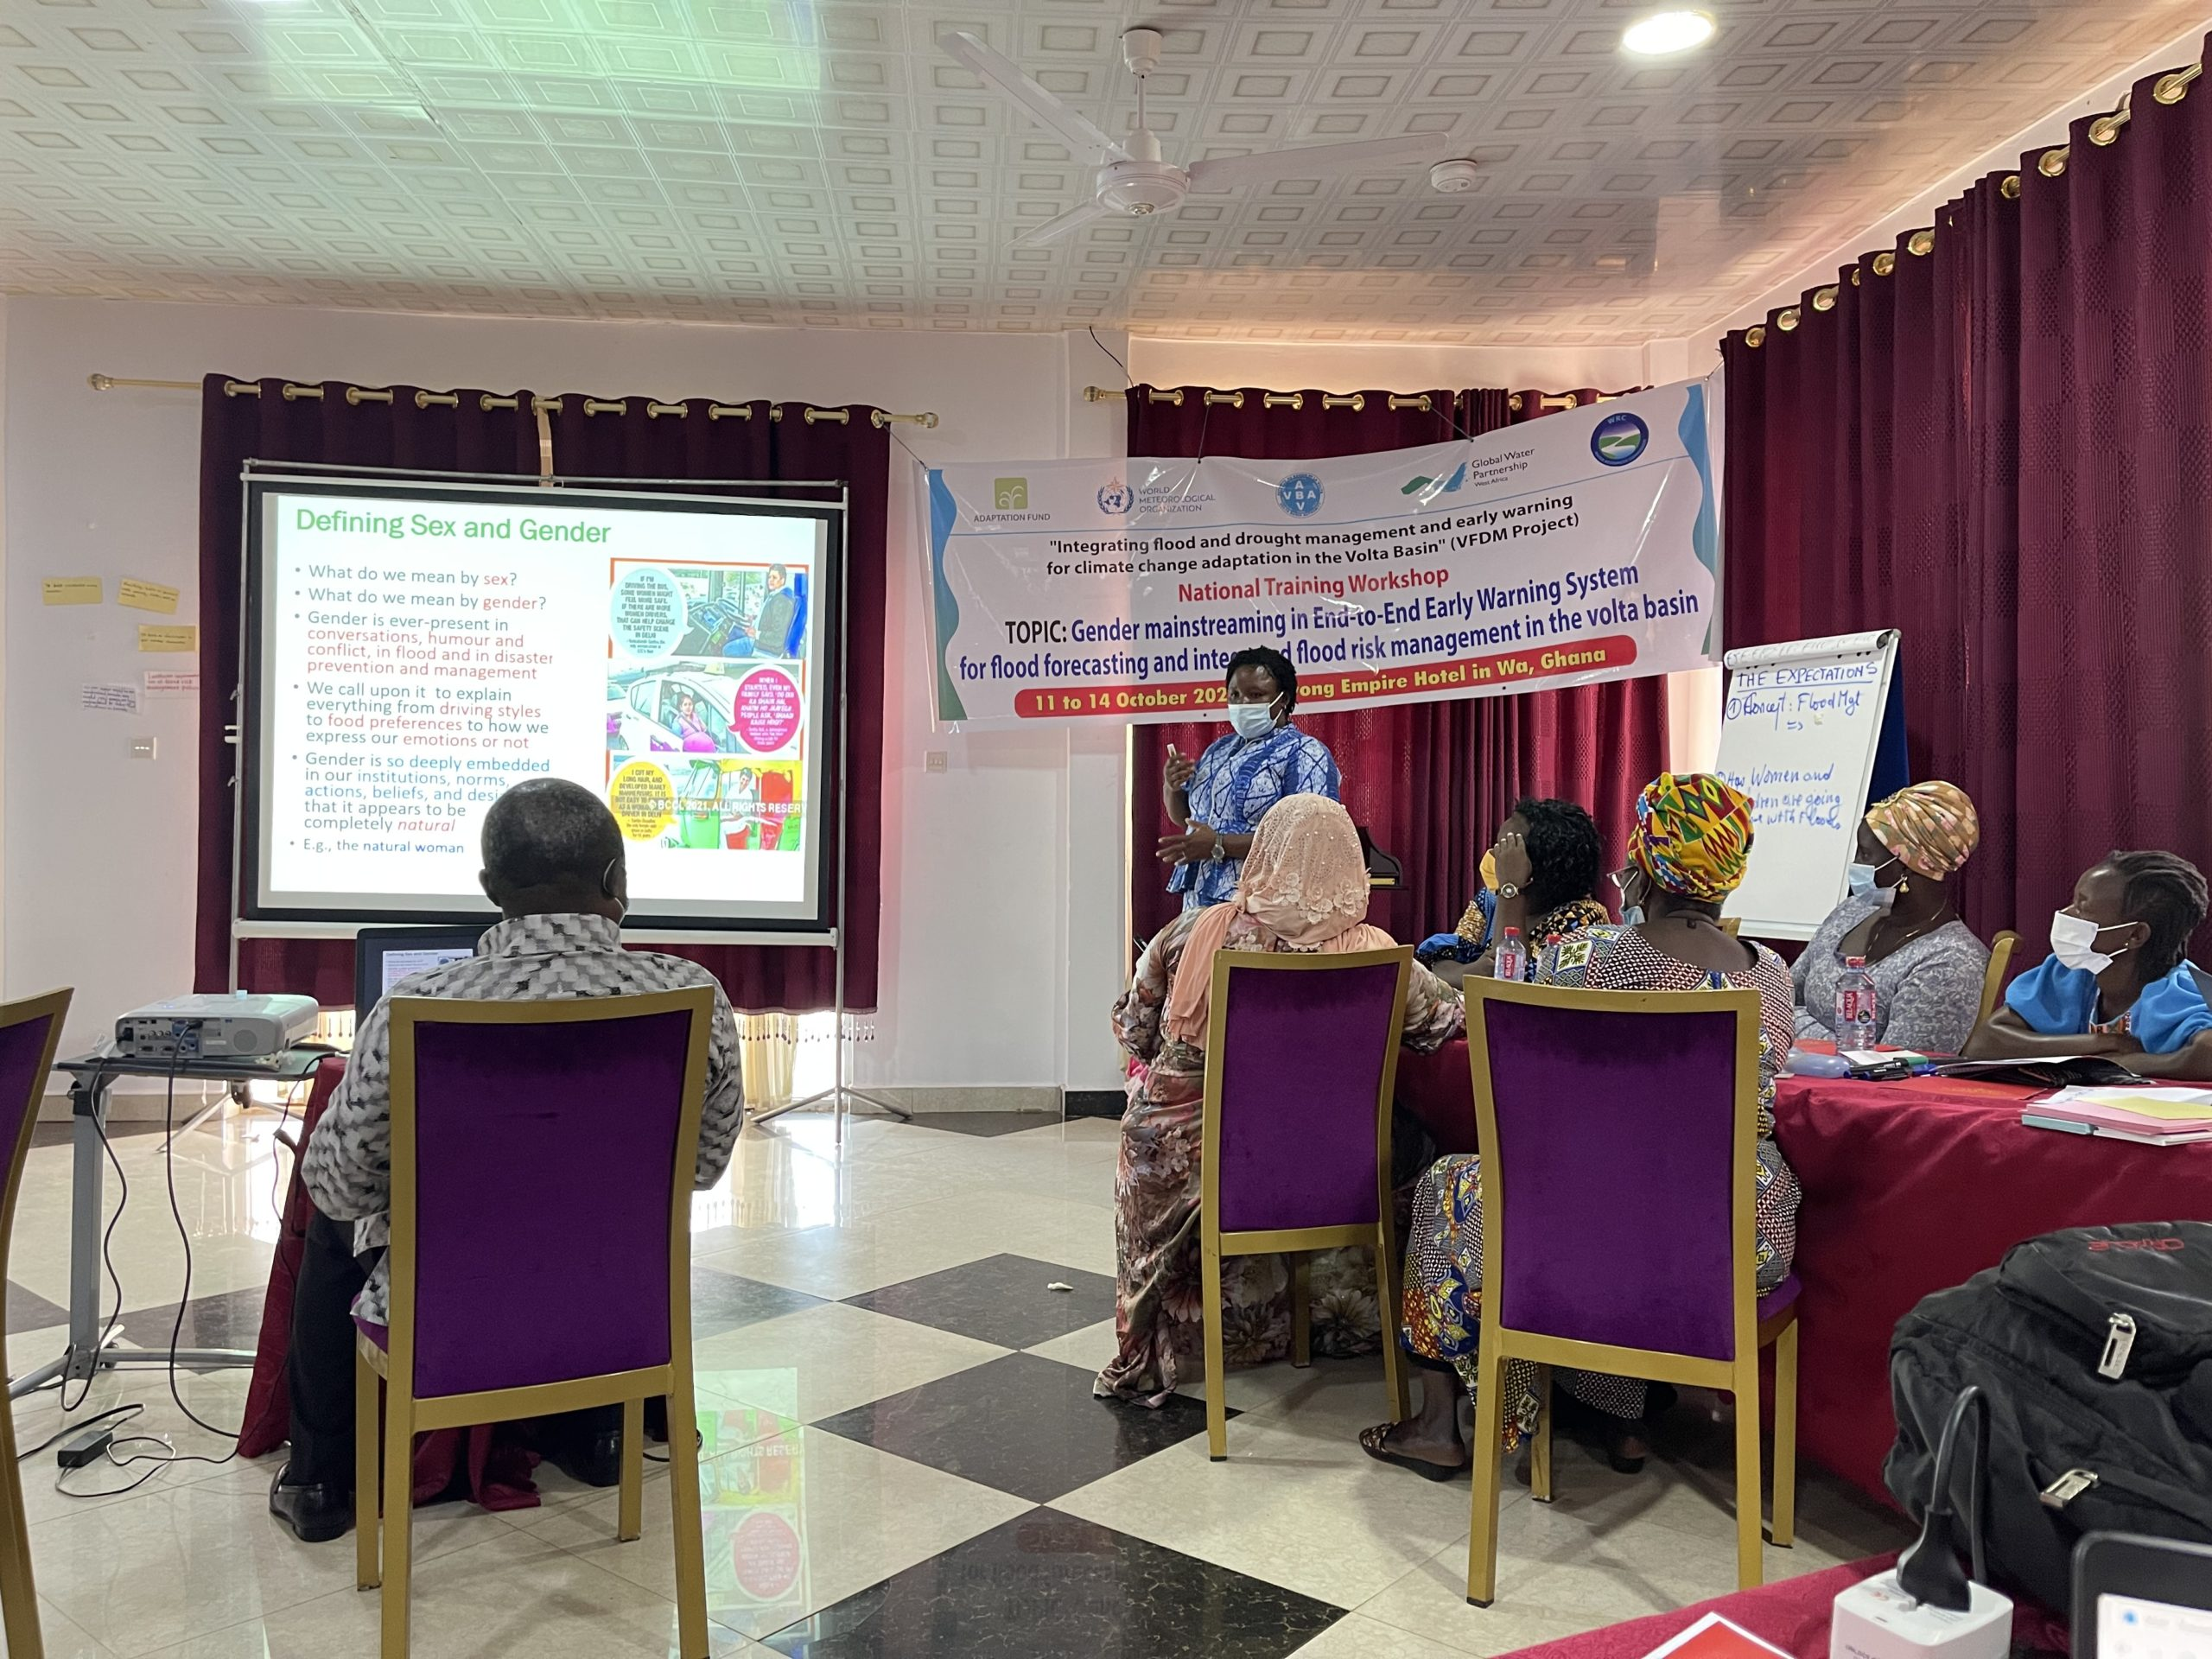
Gender Mainstreaming Workshop in the Volta Basin countries (Benin, Burkina Faso, Cote d’Ivoire, Ghana, Mali and Togo)
8 National workshops were organized for national, local stakeholders and CBOs
Main objective:
To strengthen the capacities of stakeholders of the national portion of the Volta Basin on mainstreaming gender into the E2E-EWS-FF and IFRM
Notes:
community-based organizations

Slide 3




The Hydrological value chain in flood forecasting and early warning
!
REAL-TIME DATA
COLLECTION
MODELLING & FORECASTING
EARLY WARNING DISSEMINATION
DECISION SUPPORT
RESPONSE TO WARNING
For preparing risk and vulnerability maps
Non availability of Gender disaggregated information on human settlements, access to social institutions
Lack of available social and structural information for impact-based forecasting and female forecasters
Failure to provide relevant information taking into account knowledge, mode of communication, language
Low participation of women in management bodies and decision-making fora
Lack of awareness on gender specific needs
Not involving vulnerable groups
Solution: Gender-based disaggregated data should be collected per sex and age during various assessments
Solution: Need to issue warnings based on impact to women and other vulnerable groups with relevant information adapted to their level of understanding
Solution: Gender specific timely warnings
Solution: Involve gender experts in decision making process
Solution: Gender specific needs are collected
Involving women in response phases
Notes:
To share the history and the milestones of gender mainstreaming;
Workshop objective
Assist the six countries in implementing coordinated and joint actions to improve their existing management plans at the regional, national, and local levels by taking into account lessons learned from past and current projects related to disaster risk reduction and climate adaptation

Slide 4
Important Recommendations discussed and Agreed with Decision Makers
To be ambassadors of gender integration in the E2E-EWS-FF and IFRM;
To effectively implement the post-training roadmap;
Decision-makers at the regional and local levels
Provide each river basin in Ghana with an IFRM Plan and an E2E-EWS-FF that takes into account gender concerns
Participants' Commitment
To share with colleagues the results of the workshop and the knowledge acquired along with the training materials
To ensure that gender is effectively taken into account in the flood risk prevention, preparedness and management activities of the participants' home structures
Notes:
Multiple and intersecting categories of identity markers:
Gender, sexuality, age, class, race, caste, ethnicity, indigeneity, citizenship status, religion, and ability
Intersectional issues affect how different people experience the risks and impacts of hydro-meteorological events such as floods, droughts, etc.
Floods reinforce existing gender and socio-economic inequalities
Increased vulnerabilities
Increased incidences of rape, early marriage and other forms of GBV
Increase women’s burden/triple role
What are the roles and responsibilities of women and men, boys and girls before, during and after floods?
What are the gender differences and power inequalities in the relationships involving women and men, boys and girls, aged, poor, etc. before, during and after floods? the two sexes?
Between social strata?
Low participation / involvement of women in political activities and decision-making structures
Weak and limited representation in flood management committees and other preparedness and response activities aimed at reducing the incidence of flood risks in their areas (AfDB, 2016)

Slide 5
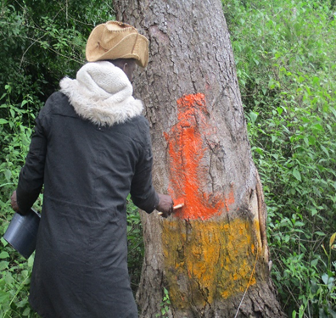
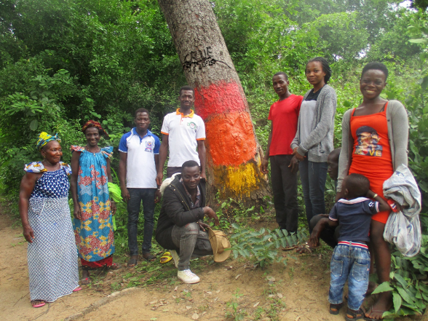
Success Stories
Safety Marking in Sangabili (Cote d’Ivoire)
This safety marking was done with participation from men and women of the community
Three markers (Yellow-Orange-Red) were installed in the community of Sangabili at the level of flooded surfaces.
which calls for vigilance for a safe evacuation.
Each marker has a designated person who will report the water level to the head of the CBFDM committee during times of flooding.

Slide 6
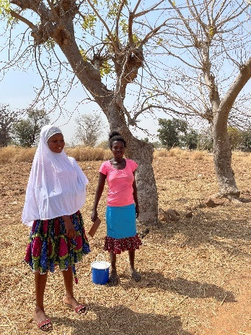
Success stories
The community-based activities implemented in the Kunkua village, Bongo District of Ghana provided opportunity for me to learn various aspects of floods and drought management. I am happy to be part of village committee now and will be involved in capacity development activities and decision-making. Also, the local meteorological station data and warning from the project EWS will provide daily and weekly bulletins which will help us to take timely decisions on harvesting and drying of millet crops.
Ms Asakibila Erica, Kunkua village, Bongo district, Ghana

Slide 7
Thank you
More information through the Poster session

